Slide 1
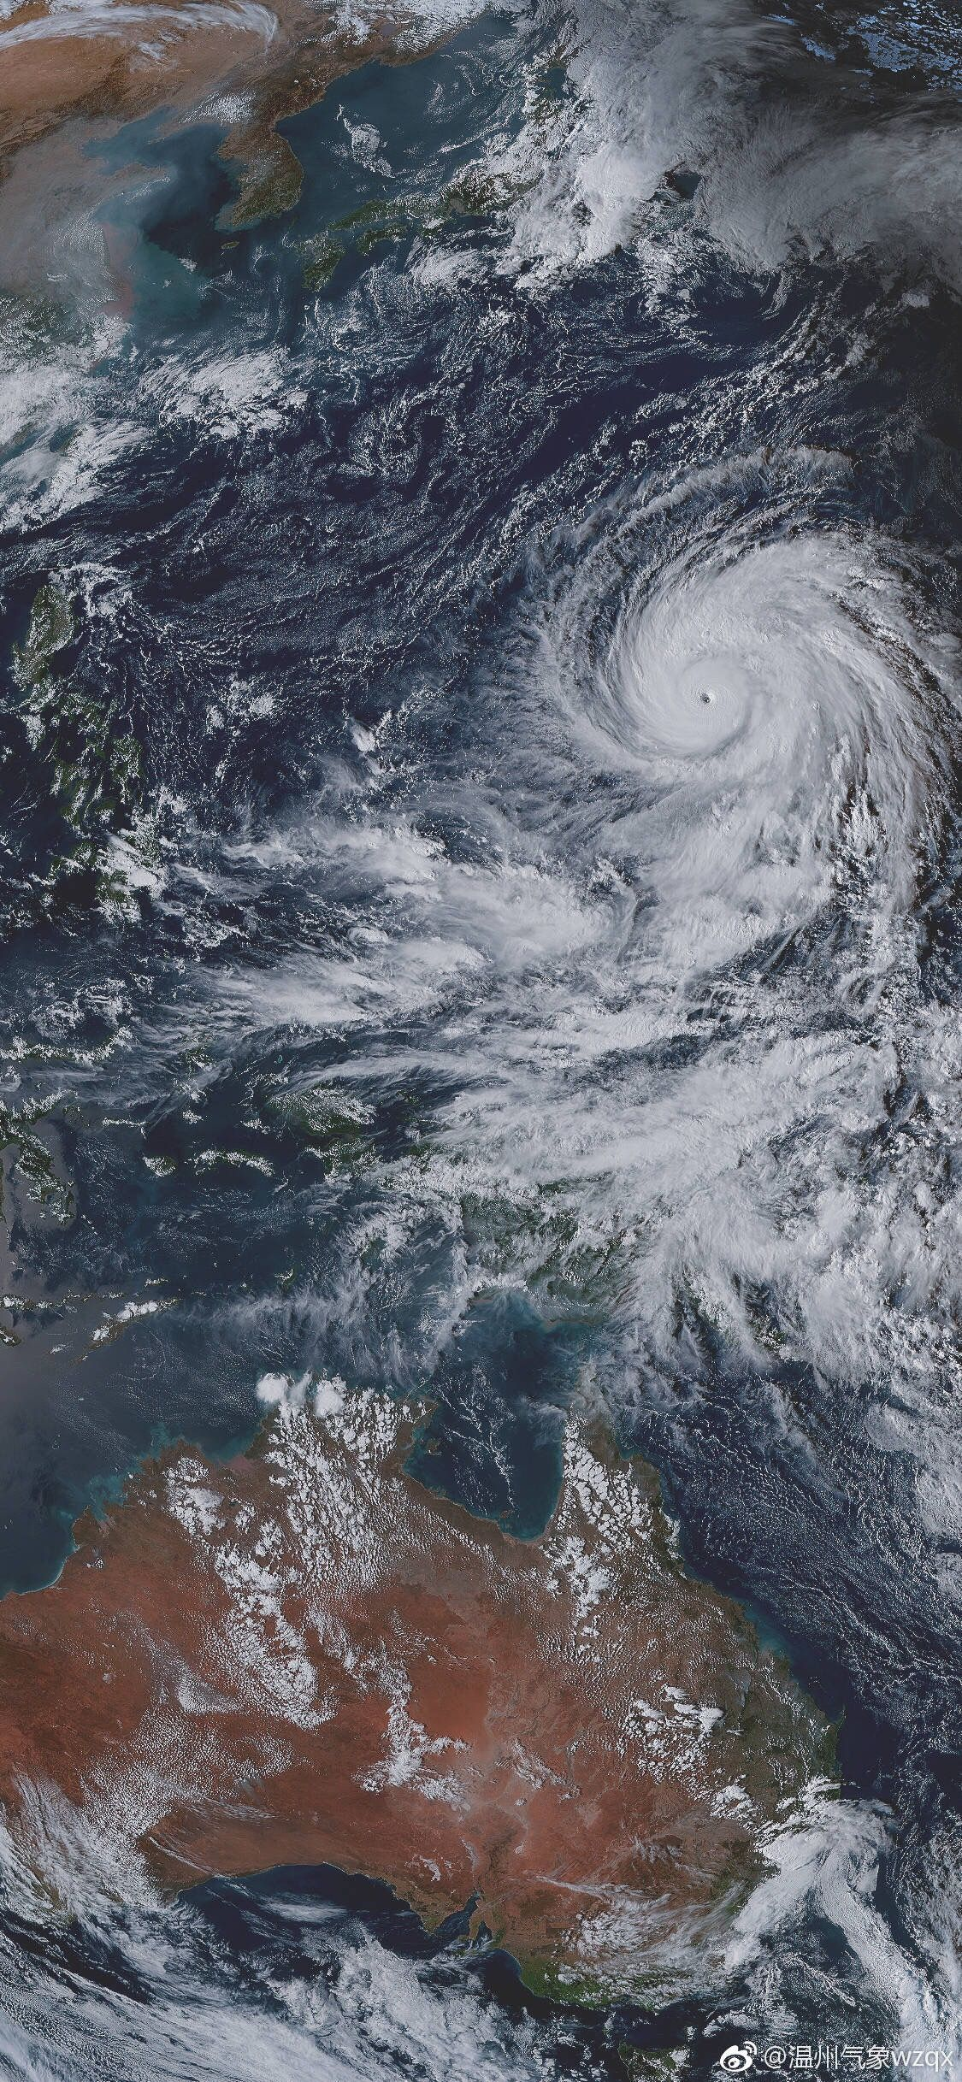
EDA to Typhoon Mitigation and Response Framework (TMRF)
Integration of Global Plans for a Better Typhoon Disaster Response
Presented by:
TEAM TYPHOON ANALYST
Alvaro, Gabriel Edrian
Palis, John Arthur
Alangilan, Christine Joy
Guerra, Marian

Slide 2
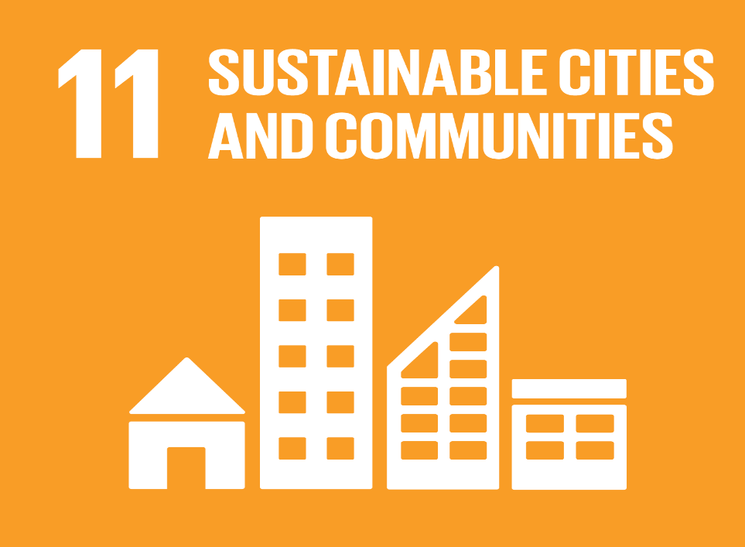
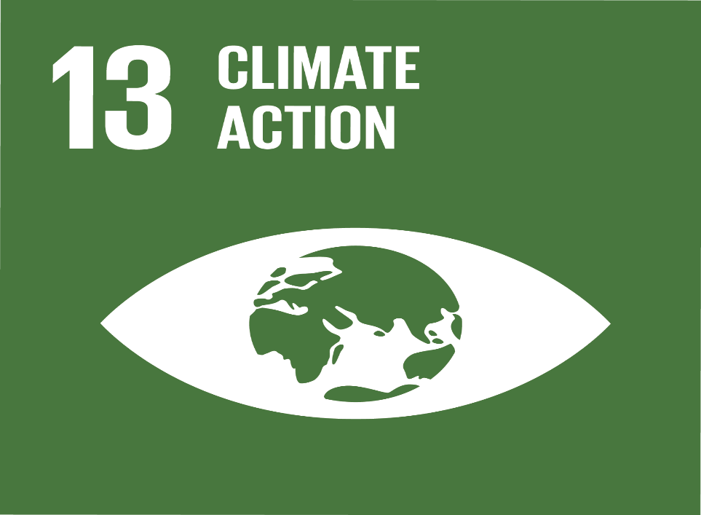
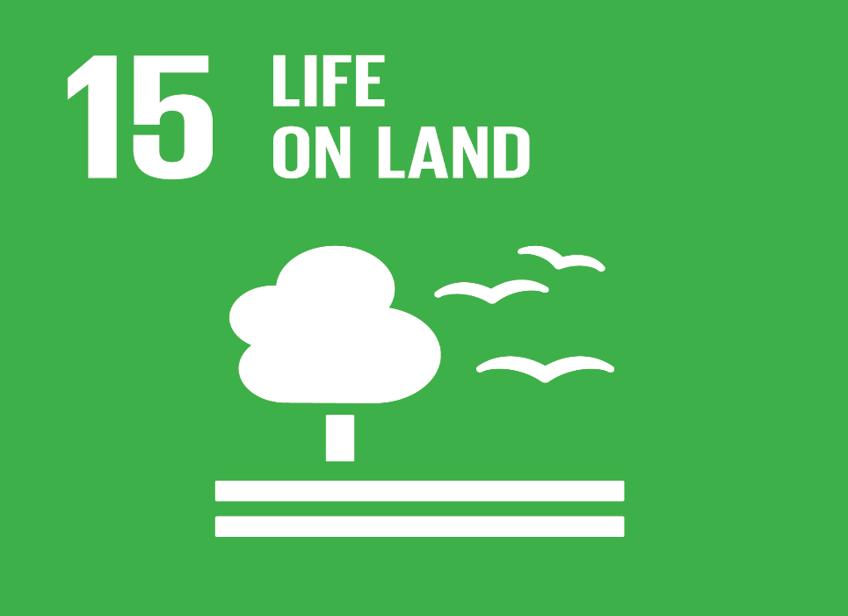
Goal 11: Sustainable Cities and Communities
Sustainable Development Goals
It stives to mitigate the negative consequences of natural catastrophes like typhoons.
Goal 13: Climate Action
It stives to take immediate action to address climate change and its consequences.
Goal 15: Life on Land
It seeks to manage forest sustainability, prevent desertification, halt and reverse land degradation, and halt biodiversity loss.

Slide 3
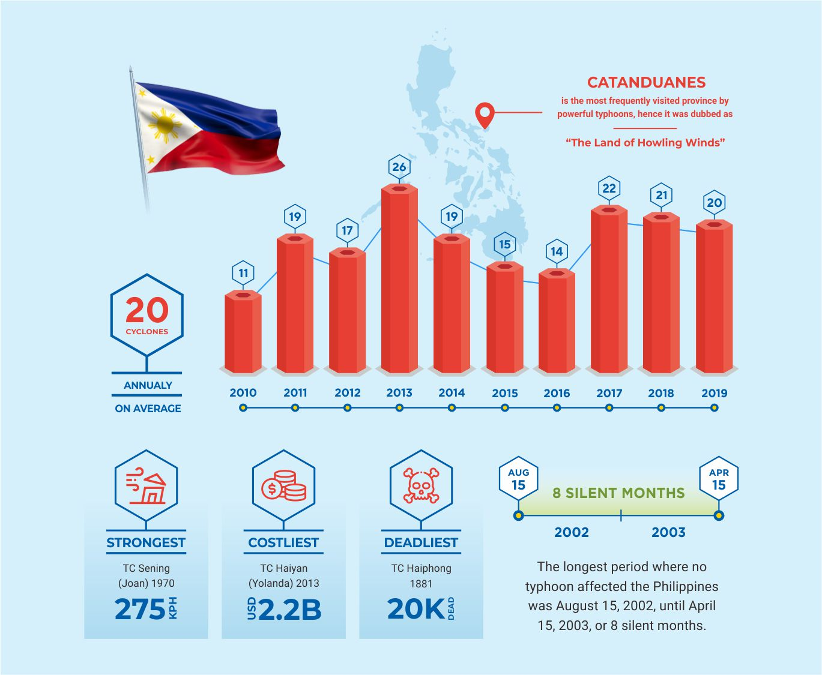
DID YOU KNOW?
- Approximately, Twenty tropical cyclones pass through the Philippine Area of Responsibility per year (Brown, 2013).
- Insufficient public awareness of storm surges caused higher casualties Tacloban city. (Commision on Audit, n.d.).
“Experience is a master teacher, even when it’s not our own.” ― Gina Greenlee

Slide 4

PROBLEM STATEMENT
The primary issue addressed by this project is the lack of a mitigation and response framework among the cities and municipalities located throughout the Philippine archipelago.

Slide 5
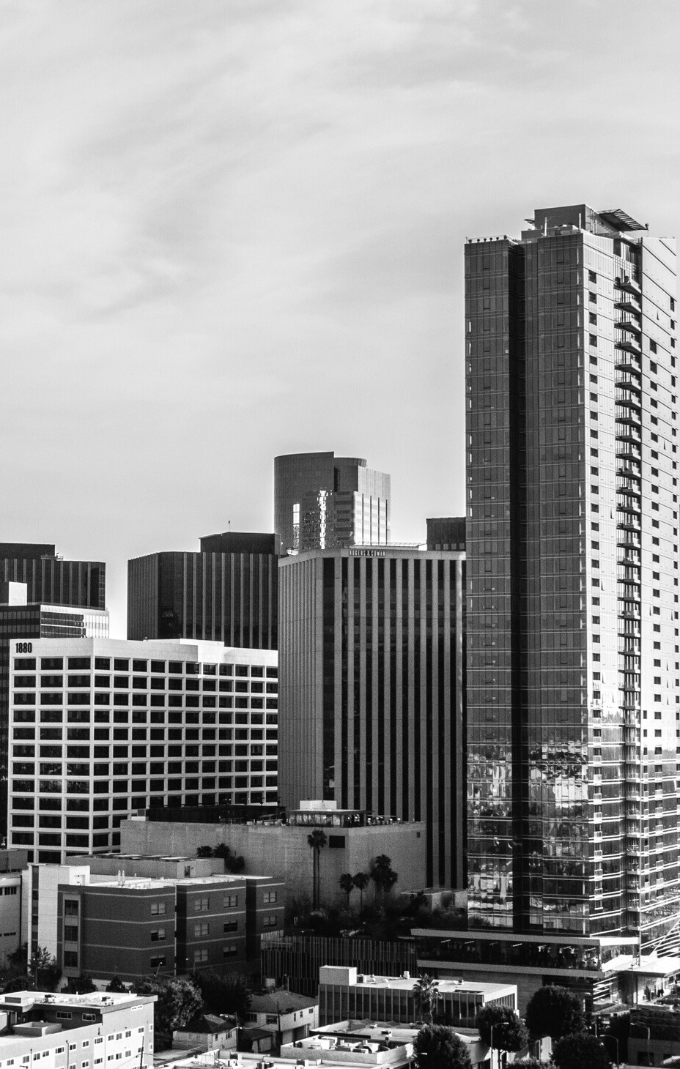

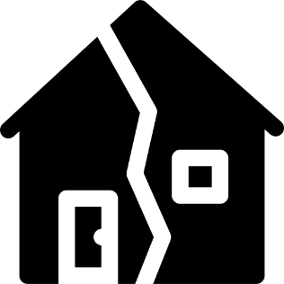
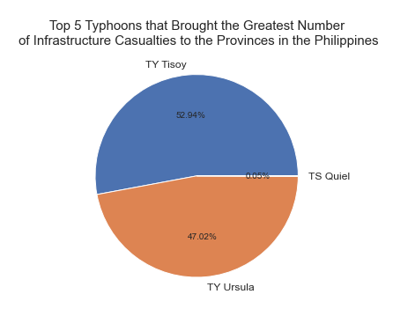
Typhoon Tisoy has the most destructive impact on the houses in every region in the Philippines from 2019.
TYPHOON TISOY
68,104
TYPHOON TISOY TYPHOON URSULA
TYPHOON QUIEL
Totally Damaged Houses
Notes:
Typhoon Tisoy had a 68,104 while TY Ursula has the second highest number with 60,483 housing damaged. Why did this happened? A recent Harvard research found that despite the fact that the Philippines is one of the most disaster-prone nations in the world, the majority of Filipino households feel unprepared for catastrophes and natural hazards due to a lack of financial resources. In 2017, Harvard Humanitarian Initiative (HHI) DisasterNet Philippines conducted the first survey of its type to gauge household preparation for disasters, reaching 4,368 families around the country (Enano, 2019). According to the survey report, just 36% of respondents felt completely prepared for disasters, while 33% reported being moderately prepared. The other third of respondents reported to be just minimally or not at all prepared for natural disasters such as typhoons, earthquakes, floods, and landslides. Over nine million Filipinos have been impacted by a natural catastrophe in the previous five years, according to the HHI. However, over 47 percent of respondents indicated they had made no preparations for these disasters. Despite the fact that the majority of respondents claimed to have discussed emergency preparations with family members, the majority do not have "go bags" or emergency bags or even first aid kits, according to the survey.

Slide 6
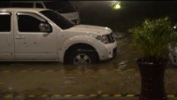

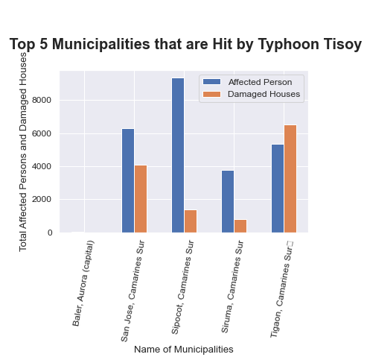
SIPOCOT, CAMARINES SUR
TYPHOON TISOY TYPHOON URSULA
TYPHOON QUIEL
136.0
Totally Damaged Houses
Source: Earth Uncut TV (2019)
Notes:
From the graph above, it can be concluded that most of the municipalities who were greatly affected by Typhoon Tisoy is from Camarines Sur, Bicol Region. These municipalities includes San Jose, Sipocol, Sinuma, and Tigaon.
In the aftermath of Typhoon Tisoy, the Bicol area (Region 5) was hit particularly severely, with over 1,200,000 people impacted and over 256,000 homes damaged or destroyed. According to 2018 data, 27 percent of Bicol's population lives below the poverty line, and its primary economic activities include fishing and farming. Prior to Typhoon Tisoy, there were significant risks among the affected population, notably among low-income households dwelling in high-risk regions and in buildings built of lightweight materials (Humanitarian Country Team, 2019). The region's geographic location renders it susceptible to natural disasters, and several regions of the region were affected by Typhoon Nina in 2017 and Typhoon Usman in 2018, prompting the communities to create emergency planning and response plans that rely largely on their own resources.

Slide 7
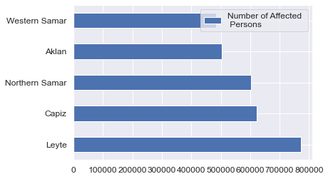


LEYTE
WESTERN SAMAR
772162.0
483308.0
AFFECTED INDIVIDUALS
AFFECTED INDIVIDUALS
Notes:
What do these provinces lack in terms of disaster preparedness, particularly for Typhoons?
According to the Policy Brief - Senate Economic Planning Office (2017), a large proportion of individuals impacted by typhoons are due to the inability of line agencies and LGUs to conduct DRRM responsibilities . The inability of line agencies and LGUs to adopt DRRM responsibilities is an often stated problem in Philippine disaster management. Insufficient personnel, lack of technical expertise and comprehension, limited financial resources, and lack of technology, such as a multi-hazard early warning system, are among the causes. The LGUs lack the technical expertise and resources necessary to fulfill their statutory responsibilities. The DILG-Bureau of Local Government Supervision's 2013 national table assessment on LGU compliance with RA No. 10121 revealed that just 23 percent of LGUs in flood-prone regions are prepared for catastrophes in terms of knowledge, institutional capacity, and coordination.

Slide 8
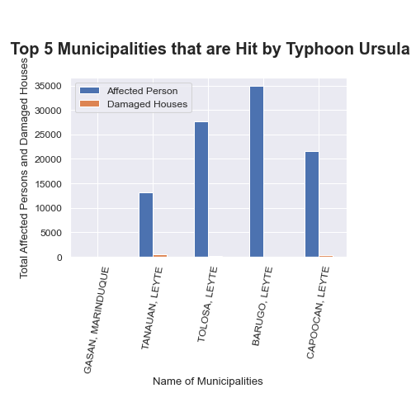


Barugo, Leyte
34932.0
TYPHOON URSULA
Barugo, Leyte
Total Affected Persons
Most affected Municipality

Slide 9
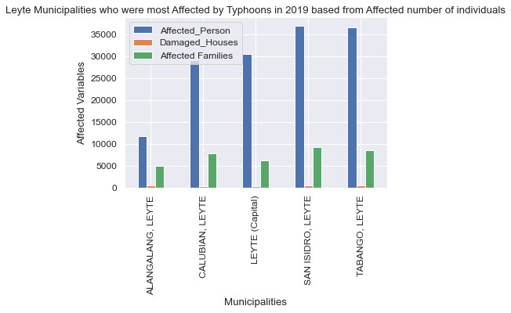
SAN, ISIDRO, LEYTE
ALANGALANG, LEYTE
36980.0
11680.0
AFFECTED INDIVIDUALS
AFFECTED INDIVIDUALS
Notes:
Leyte is weak in data banking and community preparation, which caused the massive number of affected individuals to their province.
According to Therese Mae Auman, as reported by the Asian Institute of Management (n.d.), Western Visayas, including Leyte, were severely weak in two important areas: data banking and community preparation. She saw that local administrations struggled to retain systematic data and records on prior disasters. Local Government Units in her area of responsibility do not have a database with information about prior catastrophes from which they may quickly acquire and use the material when drafting local plans. There is no progress in limiting property loss or potential deaths as a result of a community's experience with damaging storms due to the absence of data storage, which increases the likelihood that history will repeat again. The lack of community preparedness was mostly a communication issue. While populations were educated and supplied with information about evacuating as crises unfolded, execution remained a constant obstacle. There were no planned evacuation plans in place to rapidly and efficiently mobilize neighborhood people. Communities are informed of the dangers in their region, and several drills have already been done. However, according to Auman, once a calamity hits, everyone scrambles.

Slide 10
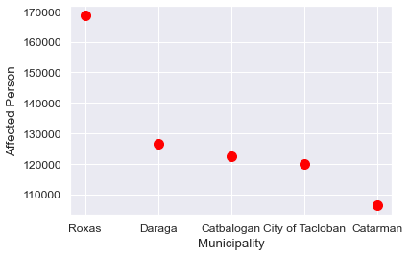
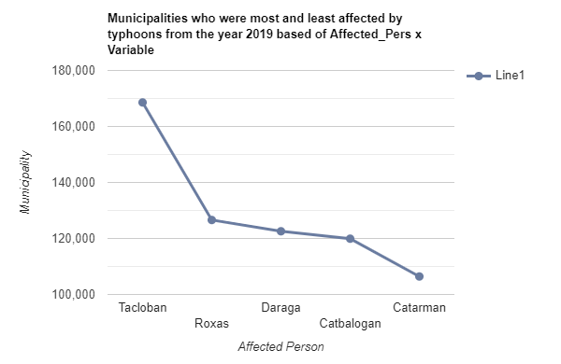
TOP 5
MUNICIPALITIES
Who had the most affected individuals in the year 2019
Notes:
CITY OF ROXAS (CAPITAL) 168580.0
Daraga (Locsin) 126595.0
CITY OF CATBALOGAN (CAPITAL) 122572.0
CITY OF TACLOBAN (CAPITAL) 119918.0
Catarman (capital) 106424.0
The ineffective execution of rules and regulations in these municipalities contributed to their severe typhoon damage. In low-lying and high-risk regions, a proliferation of establishments and informal settlers has resulted from a lack of administration and lax implementation of disaster-related rules (no building zones). According to the 2009 Annual Report of the Global Facility for Disaster Reduction and Recovery (GFDRR), as stated by Policy Brief - Senate Economic Planning Office (2017), several constructions do not comply with the Building Code and Environmental Compliance Certificates (ECCs). In certain local government units, building regulations and standards are weakened to minimize construction costs. In disaster-prone locations, a lack of control in the construction of buildings and other physical structures contributes to an increase in community risk.

Slide 11
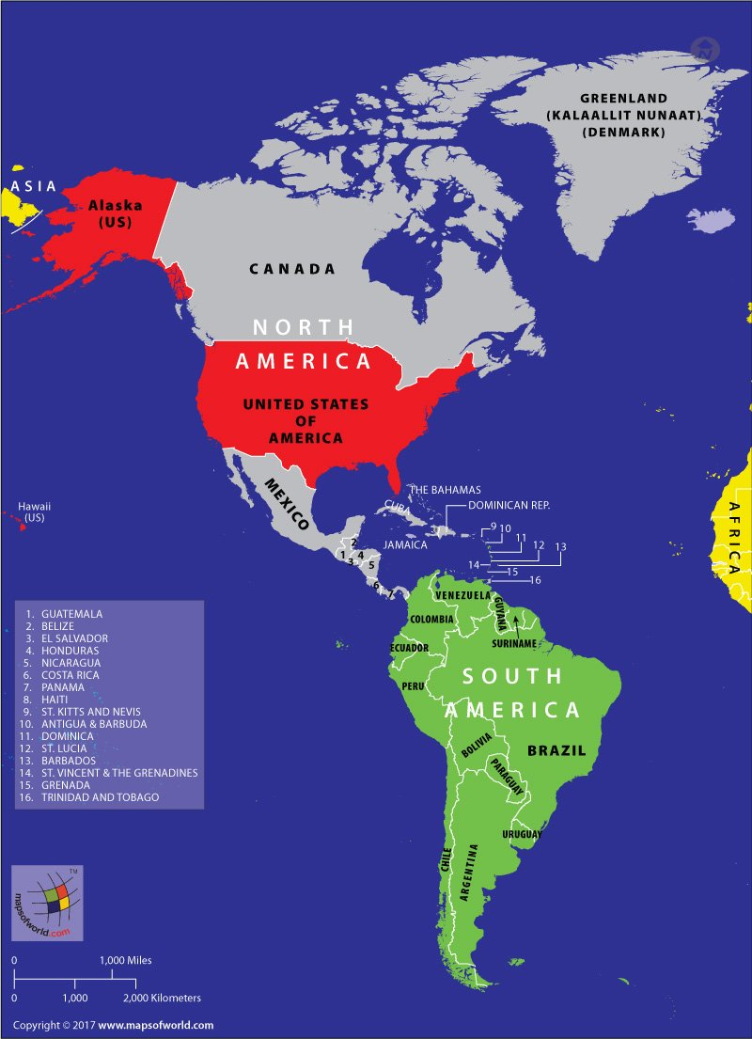
The American Continent
Source: Maps of World (2021)
Notes:
For the year 2000-2021, a total of 146 hurricanes were being recorded that hit the whole American continents, having Hurricane Katrina, Harvey, Maria, Irma, and Ida as top 5 strongest hurricanes in that timeline in terms of the total damage.
To determine the mitigation plans of affected countries that may help in formulating new mitigation plan for the Philippines, our group decided to look at the countries ranking with the :
-highest number of total affected individuals
-lowest total deaths
-and lowest total cost of damage.
The United States is adept at coping with storms on the continent after they have struck. America is significantly more prepared for storms now than it was in 2005, when Hurricane Katrina struck (The Economists, 2018). Thus, the Philippine government should examine the methods and structures it employs to further enhance our response to and mitigation of typhoons.

Slide 12
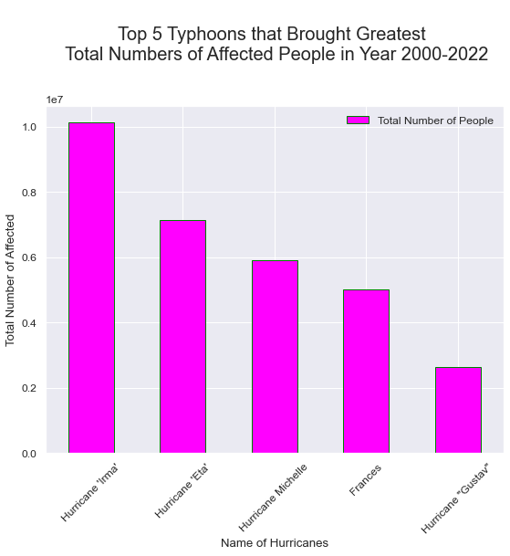
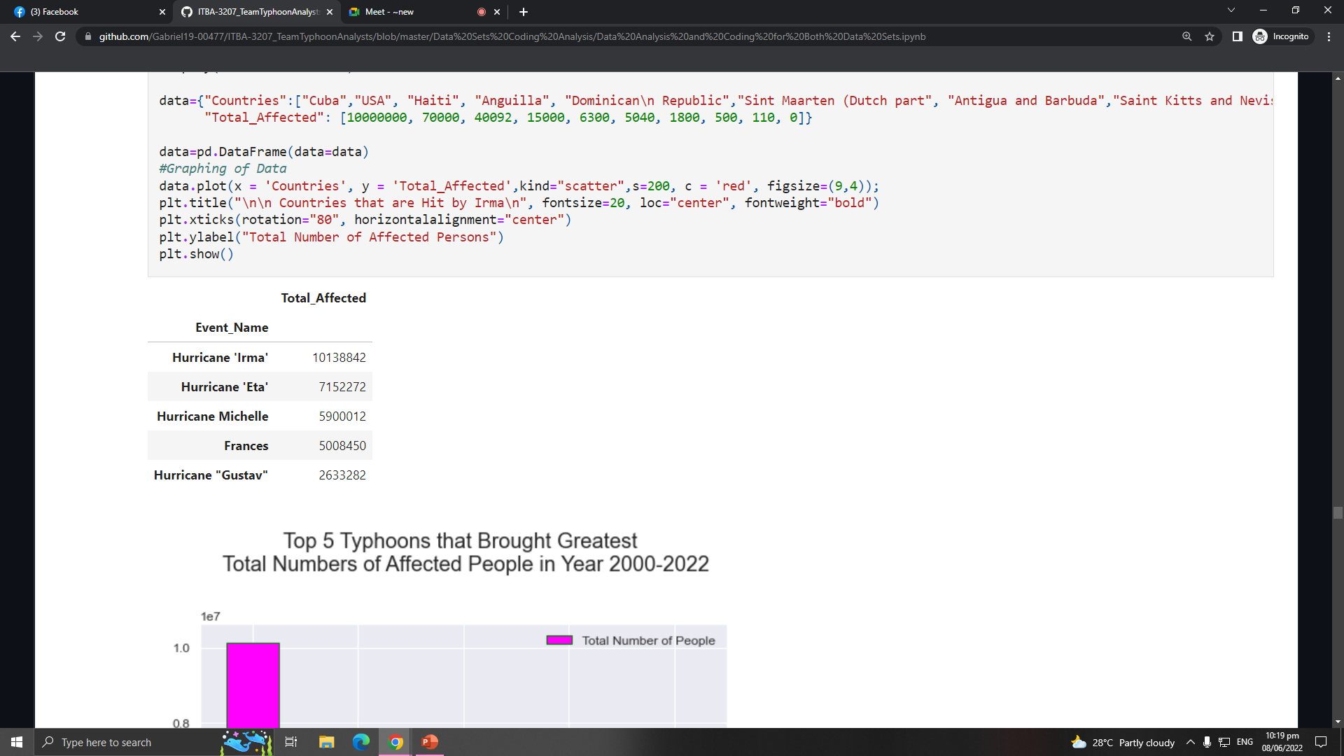

HURRICANE
IRMA
Notes:
The graph showed the top 5 hurricanes that brought the greatest number of total affected individual in different countries in Northern and Southern America. Hurricane Irma tops the list with the greatest number of total affected individual when it landed on year 2017.
Irma was a category five storm at its height, with winds reaching 295 km/h (185mph). Irma's top wind speeds were comparable with the second-strongest maximum winds ever for an Atlantic storm, according to Phil Klotzbach, research scientist at Colorado State University's Department of Atmospheric Science ("Hurricane Irma: Visual Guide," 2017). Hurricane Irma wreaked havoc on the Caribbean and then the United States' coastal states, affecting more than ten countries and territories. The International Federation of Red Cross and Red Crescent Societies (IFRC) reports varying levels of damage and needs in Antigua and Barbuda, the British, Dutch, and French Antilles, the Bahamas, Cuba, the Dominican Republic, Haiti, Saint Kitts and Nevis, and the United States and territories, among other places.

Slide 13
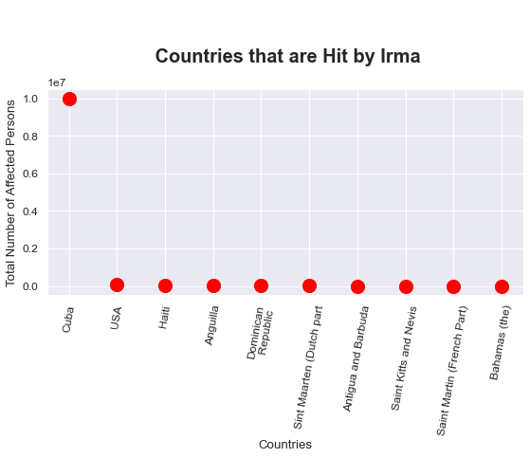
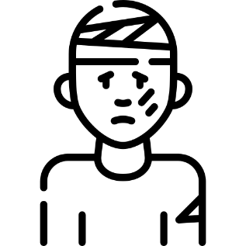
10M
HURRICANE IRMA
TOTAL AFFECTED PERSON IN CUBA BY THE HURRICANE IRMA
Notes:
Because the Caribbean and its corresponding countries such as Cuba is one of the world's most hazard-prone regions, thus; preparedness is essential. When people think of hurricane preparedness, they usually think of stocking up on food and boarding up windows just before a storm hits. However, as climate change continues to increase the intensity of hurricanes that form each year, hurricane preparedness is now required before hurricane season even begins. They propose three responses to the region's increasing frequency and severity of hurricane damage: (1) revising building codes on a regular basis for each hurricane season, (2) supporting climate-smart coastal development, and (3) building climate-proof buildings or improving buildings to withstand hurricanes (Donovan, 2017)

Slide 14
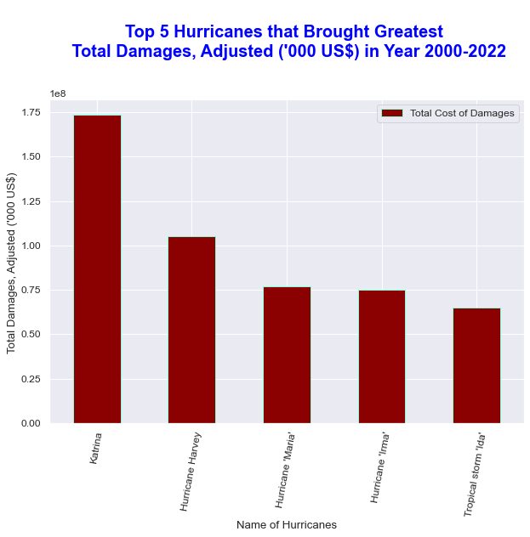
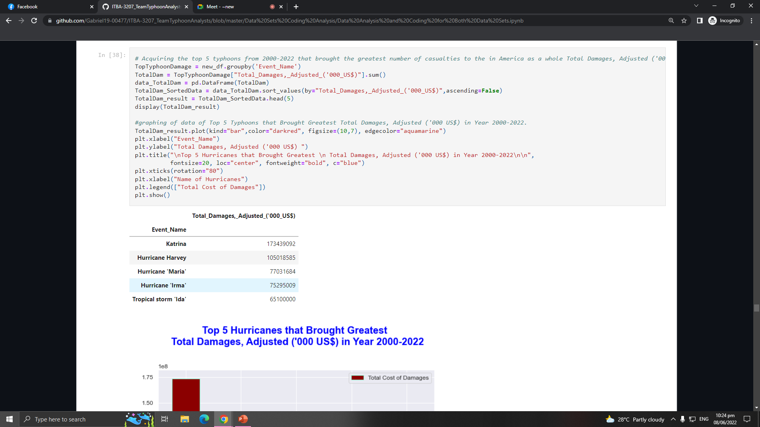
HURRICANE
KATRINA
Notes:
The graph shows the top 5 hurricanes that brought the greatest damages in from year 2000-2022 where Hurricane Katrina tops the list.
Hurricane Katrina is considered the costliest hurricane that hit the US from the year 2000-2022. It has 125 million dollars total cost of damage. However, it was adjusted for inflation, where Katrina caused an economic damage of 170 billion US dollars, $53 billion of which was insured (Buchholz, 2020).
According to Constible (n.d.), despite recent advances in areas like Florida, America's physical infrastructure, from highways and bridges to their public water systems, is not ready for the rigors of increasingly deadly hurricane seasons.
Infrastructure policies and projects must rectify decades of systemic underinvestment in those regions and account for the inequitable impacts of disruptions like power outages to be truly climate-smart. Hurricane-affected communities have started taking steps to strengthen their resilience, but numerous factors can influence their choices (Natural Disasters: Economic Effects of Hurricanes Katrina, Sandy, Harvey, and Irma, 2020). Elevating, purchasing, and restoring dwellings; flood-proofing public buildings; repairing and upgrading vital infrastructure; erecting flood barriers; and amending construction codes are all actions conducted after hurricanes. The costs and benefits of community resilience initiatives can influence a community's decision to pursue them. The frequency, severity, and location of future disasters, as well as the amount of federal help available after a disaster, all influence these costs and benefits .

Slide 15
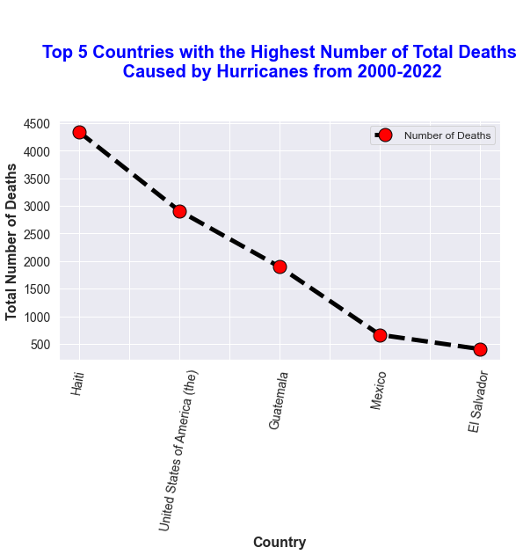
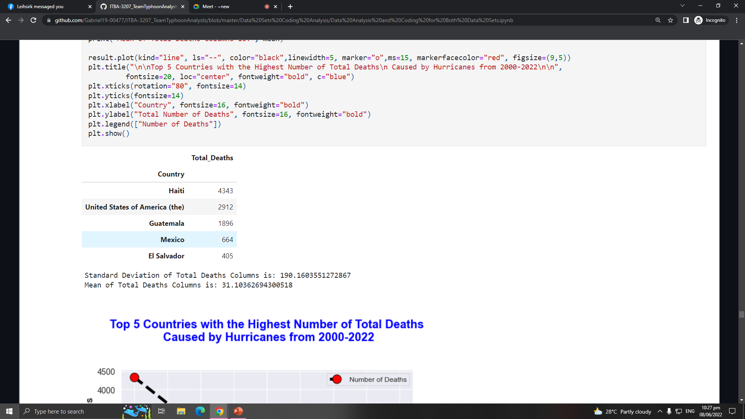
HAITI
4343
TOTAL DEATHS

Slide 16
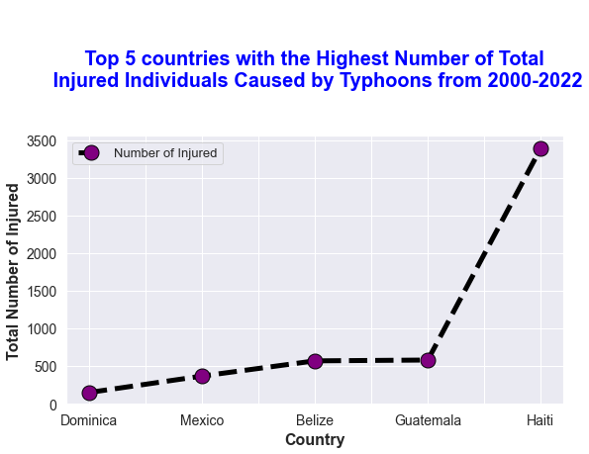
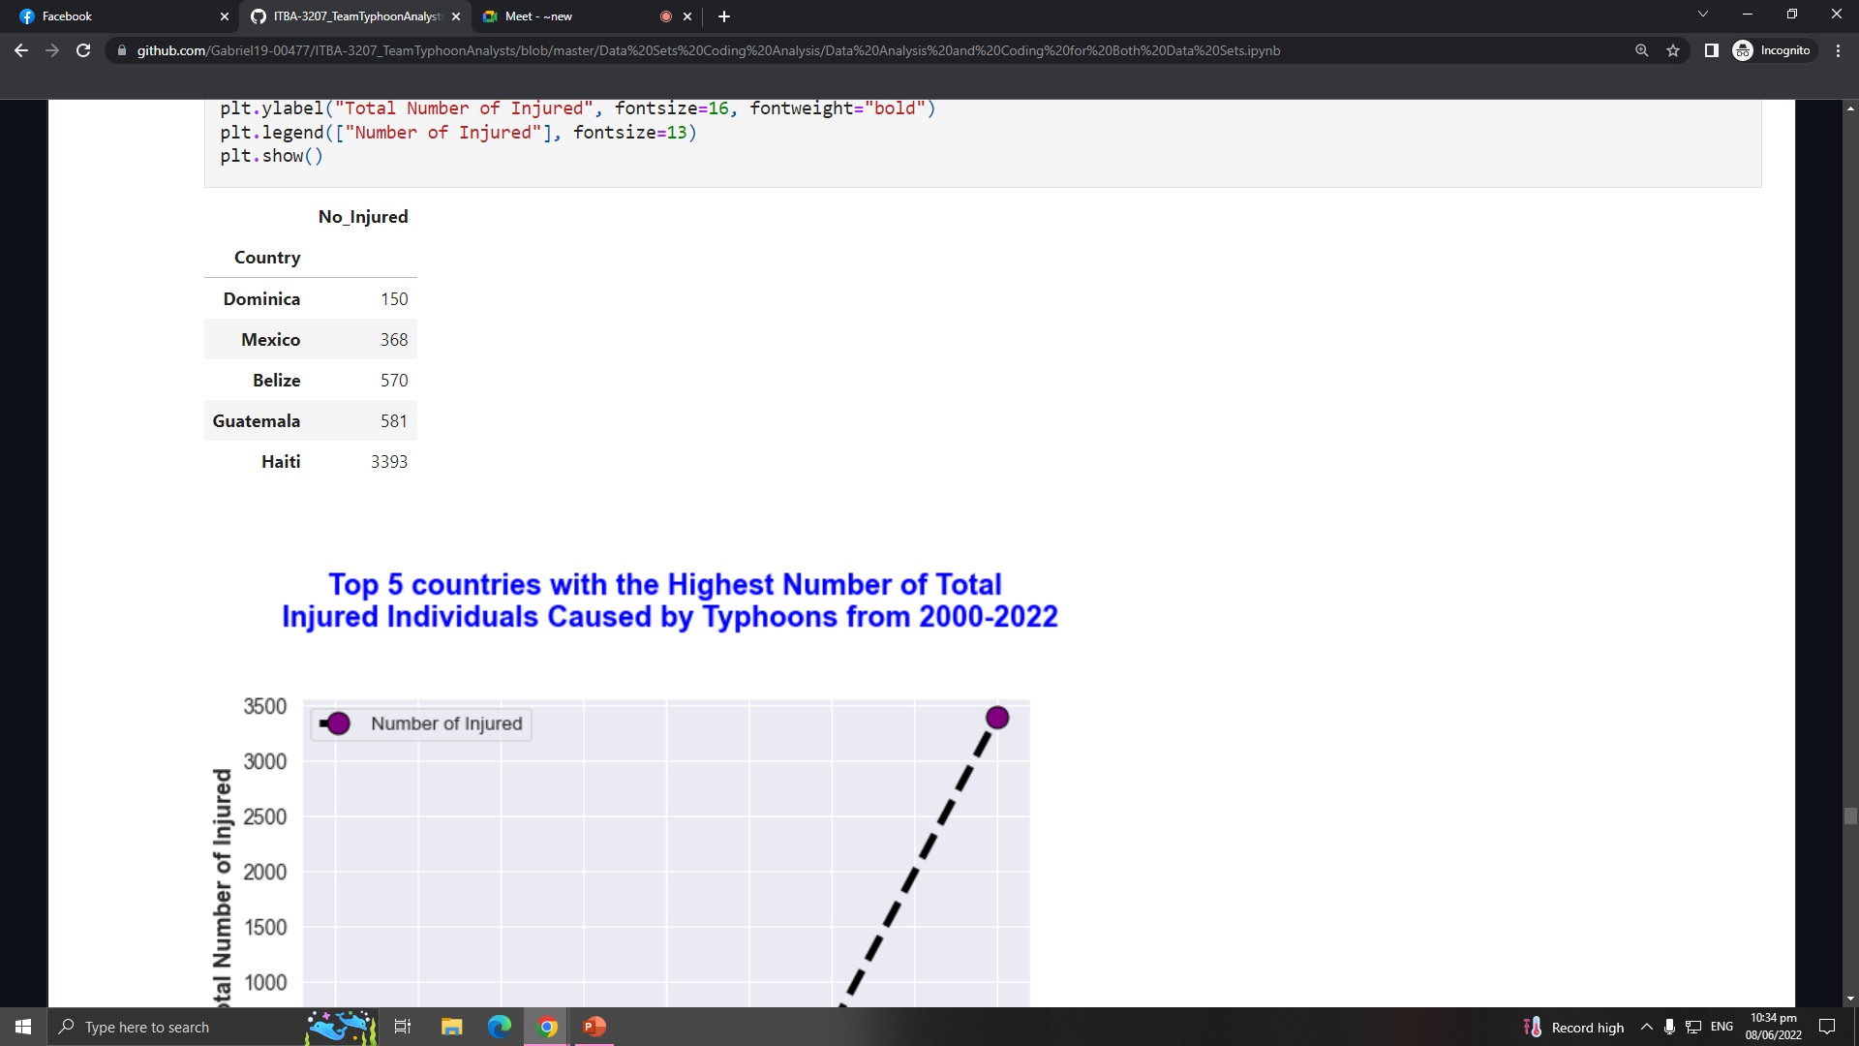

3393
150
NUMBER OF INJURED IN HAITI
NUMBER OF INJURED IN DOMINICA
Notes:
Haiti tops the records as the country with the highest total number of deaths and injured cause by hurricanes and tropical storms from the year 2000 to 2021, as shown in the two graphs.
Because Haiti is located in the hurricane belt in the Caribbean, it is susceptible to powerful storm during hurricane seasons. In an article written by Social (2018), the combination of Hurricane Ivan and Jeanne in 2004 bring damage to the country, causing massive flooding that killed less than 3000 people and injured thousands of citizens. In 2008, four hurricanes hit Haiti — Fey, Gustav, Hannah, and Ike, resulting to killing of nearly 800 people, 300 missing, and more than 500 injured (Perito, 2008). In 2016, Haiti was devastated by a category 4 hurricane named Matthew, which killed almost 600 people.
Deforestation is considered as the biggest factor for these catastrophes that contribute to the intensive flooding during the hurricane seasons, wiping the land and cause the death of the people. As mentioned by Masters, Ph. D (n.d.), Haiti is one of the poorest countries in the Western Hemisphere. Having expensive oil, cutting and burning of the trees serves as fuel and energy source of the country. Back in 1974, 25% of the forest remained that allows to withstand strong storms but in 2004, only 1.4% of the forests left, that even the not strong storms, caused massive flooding to the country due to days of rains.

Slide 17
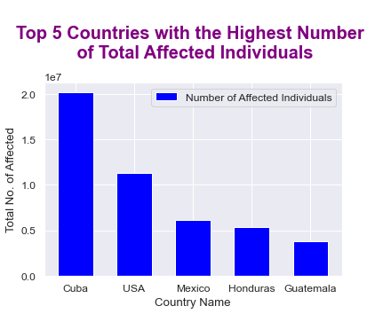
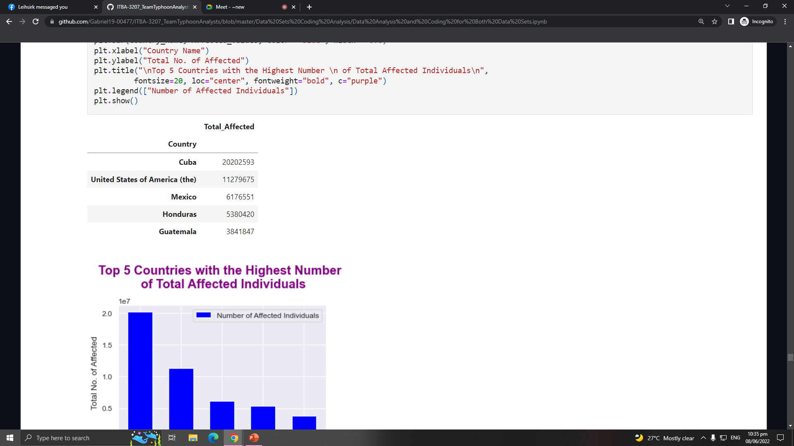
20202593.0
TOTAL AFFECTED INDIVIDUALS IN CUBA
Notes:
For the countries with highest total number of affected individuals for the entire 22 years, Cuba ranks top 1 at the list. Despite this high number of affected individuals, Cuba is currently regarded as an example for developing country hurricane risk management according to the United Nations (2004). Education is an important element of their preparation because catastrophe readiness, prevention, and response are all covered in the general education curriculum. People are constantly informed and trained to deal with natural risks in schools, universities, and workplaces. All Cubans are trained how to behave as hurricanes approach the country from an early age. Every year, they also hold a two-day hurricane risk reduction training program, complete with simulated exercises and specific preparation steps. They close schools to keep families together, and instead of having people and their belongings travel miles to shelters, they use 'community evacuation' in particularly isolated places — where individual buildings or homes have been strengthened exclusively for that purpose. Finally, the Cuban Civil Defense, a modest organization at the top, incorporates nearly everyone at the municipal level; with participation from public health and the Red Cross, local government and institutions are well prepared with risk assessments and disaster preparation. The data demonstrate the success of Cuba's disaster preparation and mitigation strategies: just 35 people have died as a result of the 16 hurricanes and tropical storms that have hit the island since 2001, with 17 of those killed by Hurricane Dennis in 2005. They are continually learning from their mistakes. Cuba wanted to improve their subterranean electricity and water lines in 2008, as they were constantly seriously damaged.

Slide 18
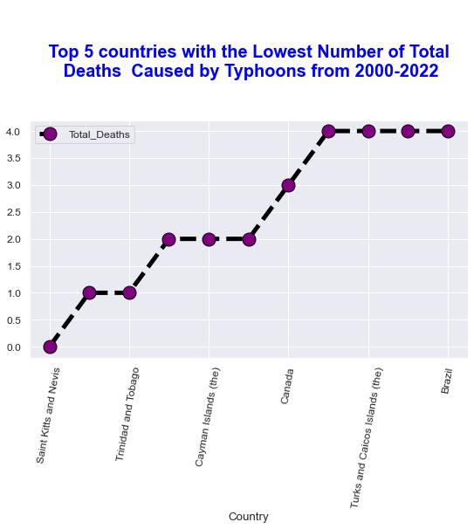
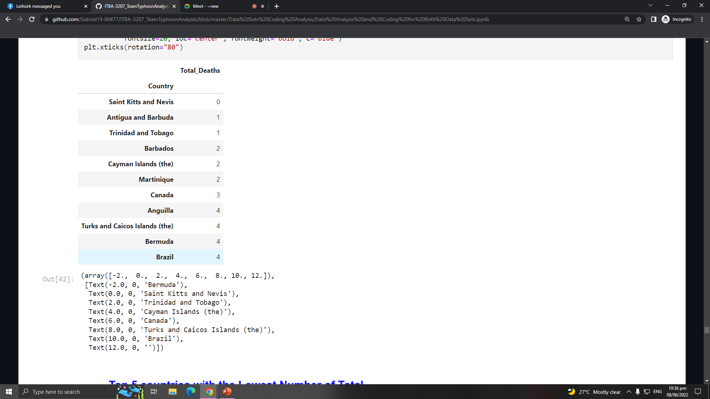
Saint Kitts and Nevis
Lowest Number of Total Deaths
Notes:
The countries with lowest total number of affected individuals from the year 2000-2021 are not frequently hit by hurricanes, sometimes have zero hurricane record in year.
For the countries with the lowest total deaths for the entire 22 years, Saint Kitts and Nevis ranks 1. In their Hurricane Emergency Plan, they have ALERT, WATCH, WARNING, and ALL CLEAR phase. During the alert phase, 72 hours before the experiencing hurricane winds, the government meet and asses the country's state of preparedness for hurricane. They advice the public to listen to all weather advisories and make contact with relevant departments to ensure that all are conserving with the plan. During the WARNING PHASE, 24 Hours before Experiencing Hurricane Winds, they notify heads of missions, regional and international embassies/missions and agencies with agreements for assistance. All relevant persons are to be notified of declaration of a Warning. Together with the Police in their District make use of the Police public address system to warn residents of the Districts of the expected time the hurricane will strike and repeat Radio messages on the location of shelters. During the blow of the hurricane, the need to monitor and report the situations as possible. When the event passed, they will proceed to ALL CLEAR phase and will assess the damage. This well-formulated mitigation plan shows success as the countries have zero deaths from year 2000-2021.

Slide 19

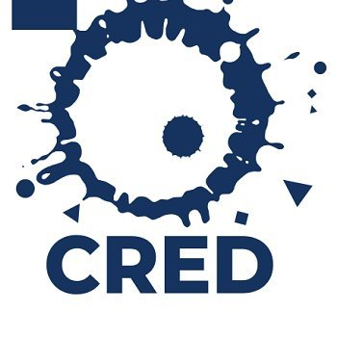
Source of Datasets
HDX
An open platform for sharing data across crises and organizations and goal of it to make humanitarian data easy to find and use for analysis.
CRED
The Centre promotes research, training and technical expertise on humanitarian emergencies, particularly in public health and epidemiology.

Slide 20




MEET THE TEAM
TEAM TYPHOON ANALYST
Gabriel Alvaro
Project Manager
John Palis
Presentation Manager
Christine Alangilan
Documentation Director
Marian Guerra
Quality Assurance Analyst

